Slide 1



My Mobile Tutor iLukkari | e-Market
Turku 2017
Notes:
GM everyone,
I’m Tan from group P2, and my friend Duc from group P3.
Our products are both mobile apps, so in this presentation we will introduce them together.

Slide 2
Content
iLukkari
an easier TUAS timetable
E-Market
make decision more easily
My Mobile Mentor
choose your future
Conclusion
Notes:
First, we will introduce the app from group P2, it is the iLukkari app.
And then, it is the e-market app from group P3.
And the next one is our future development,
another app called My Mobile Tutor.
And finally, a conclusion.

Slide 3

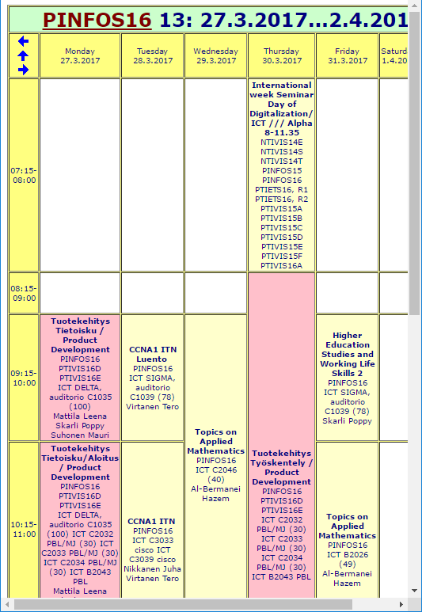
1. iLukkari
An easier TUAS timetable
A cross-platform mobile app
For TUAS students and staffs
2. E-Market
make decision more easily
To check the daily schedule easily
3. My Mobile Tutor
choose your future
4.
Conclusion
Notes:
Let’s start with iLukkari app.
This is a cross-platform mobile for TUAS students and staffs can check their daily schedule easily.
The idea of this app is to give an easier TUAS timetable.
Because the current TUAS timetable website is not compatible with small screens.

Slide 4
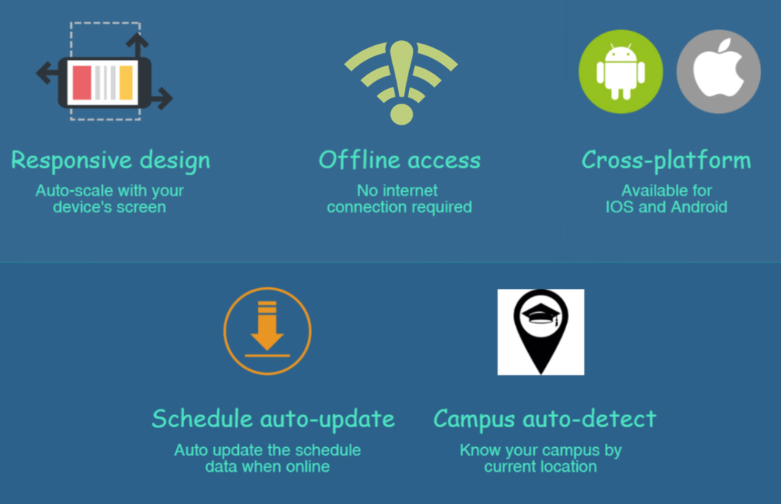
1. iLukkari
An easier TUAS timetable
2. E-Market
make decision more easily
3. My Mobile Tutor
choose your future
4.
Conclusion
Notes:
This app offer a responsive UI, offline access, cross-mobile-platform,
As well as the schedule data will be updated automatically,
The app can also detect the current campus location.

Slide 5
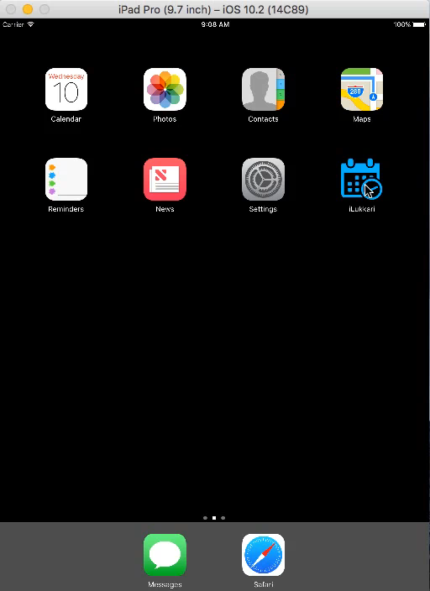
Demo
1. iLukkari
An easier TUAS timetable
2. E-Market
make decision more easily
3. My Mobile Tutor
choose your future
4.
Conclusion
Notes:
This is the demo of our prototype.
(run the video)
It’s quite simple currently.
Now my friend will talk about his app.

Slide 6


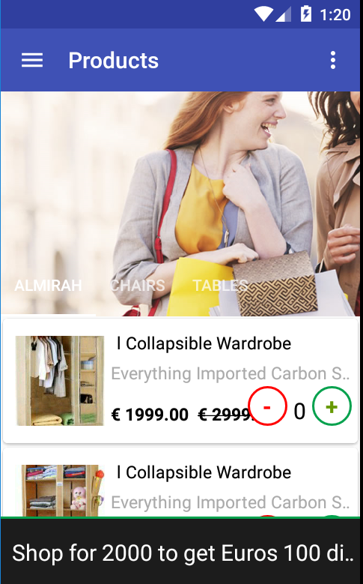
E-Market mobile app
to seek for
online products
easily
1. iLukkari
An easier TUAS timetable
2. E-Market
make decision more easily
3. My Mobile Tutor
choose your future
4.
Conclusion

Slide 7




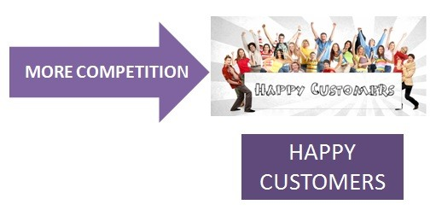



1. iLukkari
An easier TUAS timetable
Collect products’ info
Products notification
Online purchasing
2. E-Market
make decision more easily
3. My Mobile Tutor
choose your future
4.
Conclusion

Slide 8
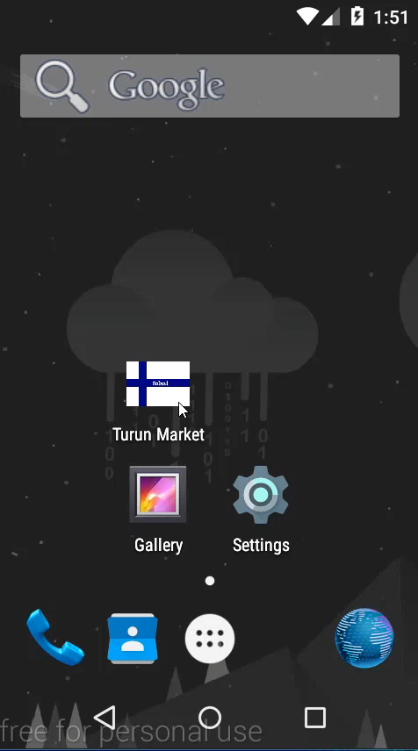
Demo
1. iLukkari
An easier TUAS timetable
2. E-Market
make decision more easily
3. My Mobile Tutor
choose your future
4.
Conclusion

Slide 9
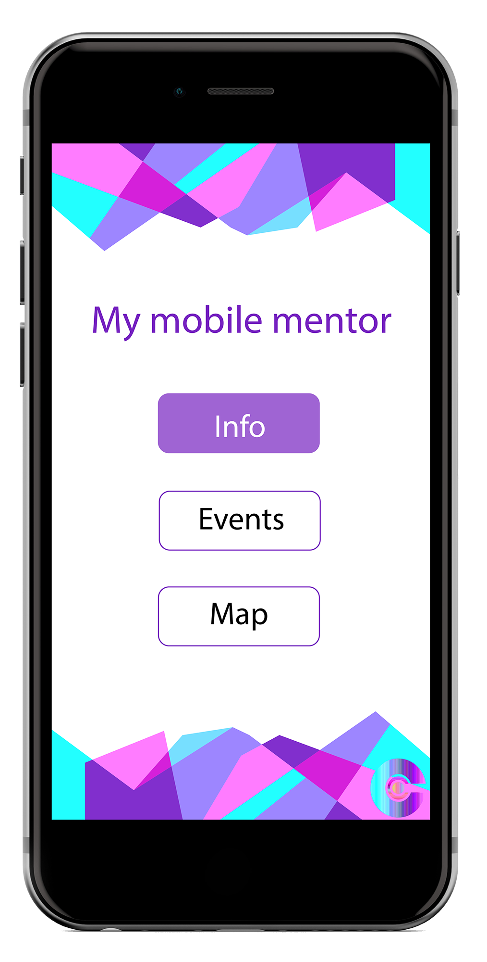
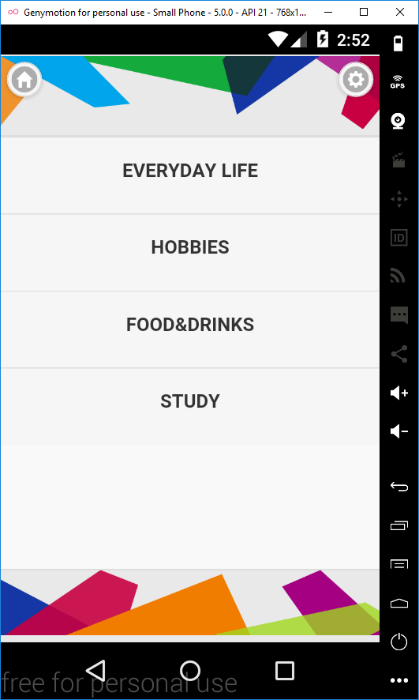
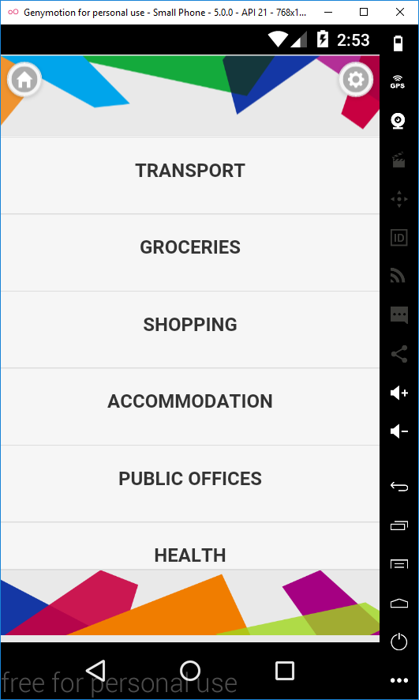

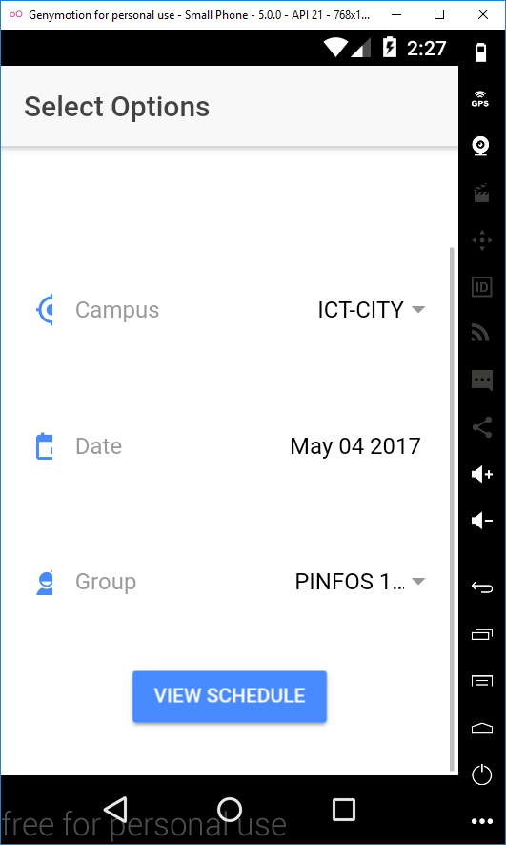
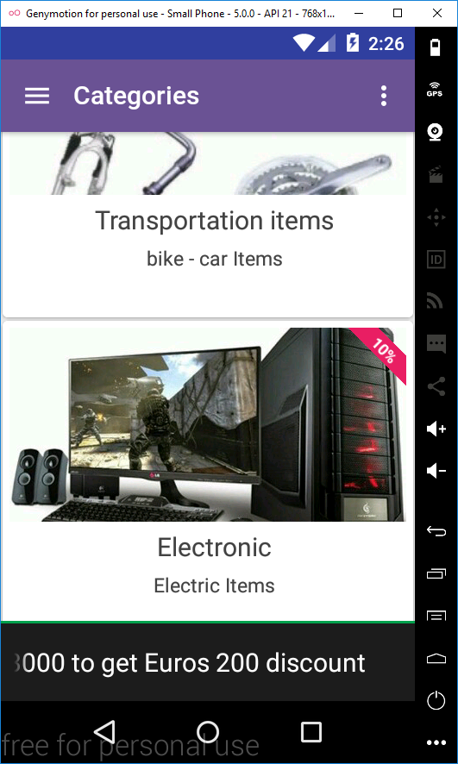
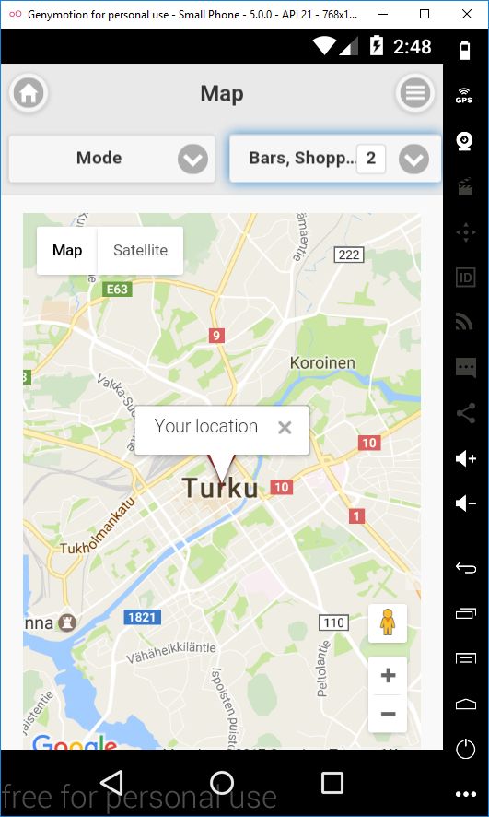
1. iLukkari
An easier TUAS timetable
2. E-Market
make decision more easily
3. My Mobile Tutor
choose your future
4.
Conclusion
Notes:
Ok, Thanks Duc,
and that’s about our apps.
Luckily, during our development process, we have met a company who is developing their app also.
And this is their app: My Mobile Mentor.
With the idea is to centralize information around Turku into just one app.
The app offers many kinds of information, including information from our apps.
We’re currently working, trying to release the first version during this August,
Especially for international students who will come in September can make use of it.

Slide 10
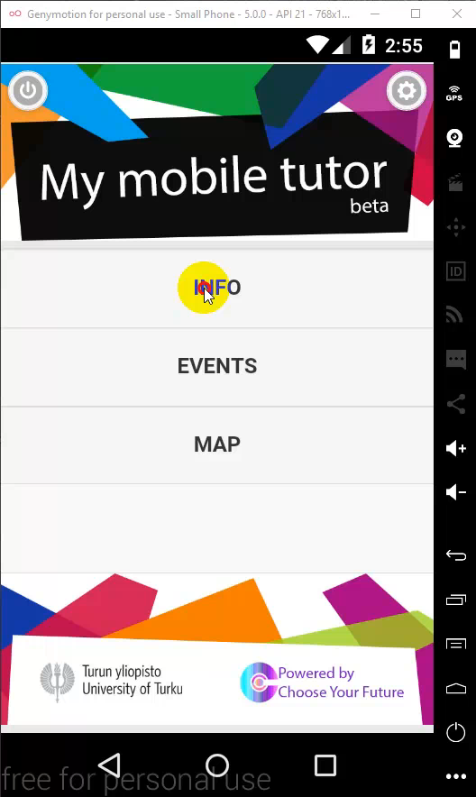
Demo
1. iLukkari
An easier TUAS timetable
2. E-Market
make decision more easily
3. My Mobile Tutor
choose your future
4.
Conclusion
Notes:
And again, this is the demo for that app. It’s just a beta version.

Slide 11

Future development
1. iLukkari
An easier TUAS timetable
2. E-Market
make decision more easily
3. My Mobile Tutor
choose your future
4.
Conclusion
Notes:
So that’s all about the apps.
Ok, Let’s relax with our video advertisement about collecting information of TURKU.

Slide 12


Notes:
THANK YOU.

